Slide 1
Macroeconomics マクロ経済学
Chap 12. Consumption and Savings
第１２章．消費と貯蓄

Slide 2
Among Gross Domestic Expenditure = Aggregate Demand, the proportion of consumption (private final consumption) is about 60%. Center of the economy.
Consumption is the final goal of economic activity ⇒ It is easy to understand the economy, when we start with analysis of consumption.
Microeconomics = to analyze how individual consumers demand each consumer good with given individual prices. ⇒price analysis
Macroeconomics = to analyze the economic activity of one country as a whole focusing on income as aggregates. ⇒ income analysis
Representative subject = microscopic rational consumers are aggregated in the macro economy, as if a single rational consumer acts on behalf of the whole consumers
The fallacy of composition by Samuelson = the behavior of the entire consumers of the macro economy is not necessarily the same as the behavior of a micro-rational consumer
⇒Microeconomic foundations of macroeconomics
国内総支出＝総需要の中で、消費（民間最終消費）の割合約6割、経済の中心
消費が経済活動の最終目的だから⇒消費の分析から始めることが理解しやすい。
ミクロ経済学＝個々の消費者が個別の価格を所与として各消費財をどのように需要するかを分析、価格分析（price analysis）
マクロ経済学＝一国全体の経済活動を集計量（aggregates）としての所得を中心に分析、所得分析（income analysis）
代表的主体（representative subject）＝ミクロの合理的な消費者がそのままマクロで集計されて、あたかも1人の合理的消費者が全体を代表して行動する場合
サミュエルソンの合成の誤謬（fallacy of composition）＝マクロの消費者全体の行動はミクロの合理的な消費者の行動と必ずしも同一でない場合
⇒マクロ経済学のミクロ的基礎付け（microeconomic foundations of macroeconomics）

Slide 3
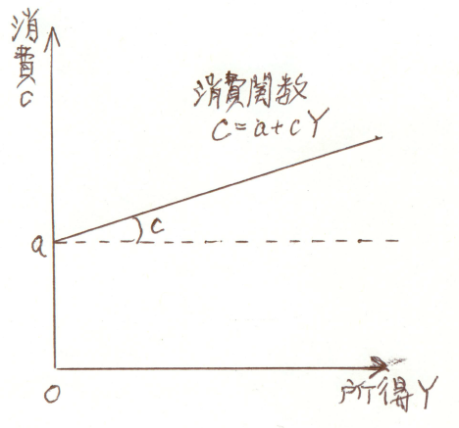
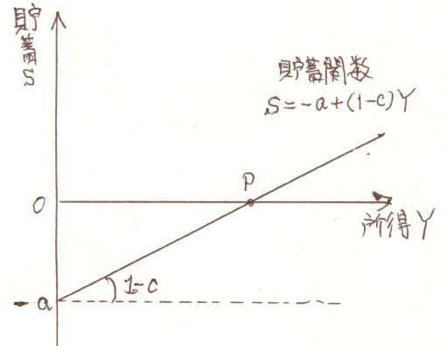
１．Consumption・Savings and Income: Absolute Income Hypothesis 消費・貯蓄と所得：絶対所得仮説
Consumers decide on consumption expenditure for each consumable good to maximize utility according to their income constraints under the prices given in the market. Consumption expenditure decreases if income decreases, and consumption expenditure increases as income increases. ⇒ consumption function is a function of consumption C and income Y. C = C (Y) If you write its proportional constant as c in lowercase letters, C = a + cY , a> 0, 0 <c <1 To specify a functional form concretely.= specification of function Consumption function is depicted by a consumption curve in geometry.
消費者は市場で所与の価格の下で、所得制約に従って効用を最大化⇒各消費財への消費支出額を決定。所得が減れば消費支出は減り、所得が増えれば消費支出は増える。
⇒消費関数（consumption function）
＝消費C（consumption）と
所得Y（income）の関数 C＝C(Y)
その比例定数を小文字でcと書けば、
C＝a＋cY a＞0，0＜c＜1
関数形を具体的に特定化
＝関数の特定化（specification）
消費曲線（consumption curve）で描ける

Slide 4
１B．Consumption・Savings and Income: Absolute Income Hypothesis 消費・貯蓄と所得：絶対所得仮説
Basic Consumption : Even when income Y is zero, consumption as low as a is necessary to survive. Constant term a = intercept of vertical axis a = basic consumption. For example, if your income is zero, you can not live a life unless you have at least 40,000 yen in 1 month
Marginal propensity to consume (marginal propensity of consumption: MPC)
When the income increases by 10,000 yen, your consumption increases 6,000 yen. Then 6,000 / 10000 = 0.6 = c c is defined as marginal propensity to consume (marginal propensity of consumption: MPC) 0 <c <1
所得Yがゼロの時でも、生きていくためには最低限aだけの消費は必要となる。定数項a＝縦軸の切片a＝基礎消費（basic consumption）。
例えば所得がゼロでも1ヶ月に最低4万円= aないと消費生活ができない場合
所得が1万円増えると6千円消費が増える場合、6000/10000＝0.6＝ c 、このcを限界消費性向（marginal propensity to consume; marginal propensity of consumption: MPC） 0＜c＜1

Slide 5
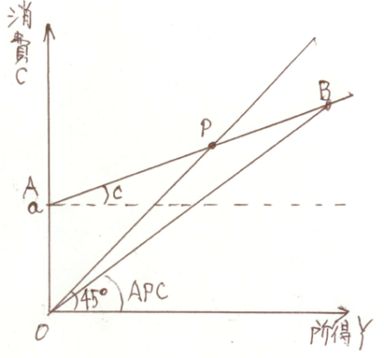
１C．Consumption・Savings and Income: Absolute Income Hypothesis 消費・貯蓄と所得：絶対所得仮説
Absolute income hypothesis = hypothesis that consumption C depends on basic consumption a and absolute level Y of income, John Maynard Keynes
Savings S = remaining income after you consumed from income.
Income = consumption + saving, Y = C + S
Savings function S = S (Y)
Saving function based on absolute income hypothesis S = - a + (1 - c) Y, a> 0, 0 <c <1 1 - c = marginal propensity to save; (Marginal propensity of saving: MPS)
絶対所得仮説（absolute income hypothesis）＝消費Cが基礎消費aと所得の絶対水準Yに依存して決まるという仮説、ジョン・メイナード・ケインズ
貯蓄S（savings）＝所得のうち消費した残り
所得＝消費＋貯蓄, Y＝C＋S
貯蓄関数（savings function） S＝S(Y)
絶対所得仮説に基づく貯蓄関数
S＝－a＋（1－c）Y, a＞0，0＜c＜1
1－c＝限界貯蓄性向（marginal propensity to save;
marginal propensity of saving: MPS）

Slide 6
２．Average & Marginal Propensity to Consume, Average & Marginal Propensity to Save 平均消費性向と限界消費性向、平均貯蓄性向と限界貯蓄性向
Average propensity to consume (average propensity of consumption: APC)
= C / Y, C / Y = a / Y + c
Average propensity to save (APS) = S / Y , S / Y = 1 - (a / Y + c)
Average propensity to consume + average propensity to save = 1
C / Y + S / Y = Y / Y = 1
Marginal propensity to consume = dC / dY, dC / dY = C '(Y) = c> 0
Marginal propensity to save = dS / dY, dS / dY = d (Y - a - cY) / dY = 1 – c
Marginal propensity to consume + marginal propensity to save= 1
dC / dY + dS / dY = dY / dY = 1
平均消費性向（average propensity to consume; average propensity of consumption: APC）＝C／Y, C／Y＝a／Y＋c
平均貯蓄性向（average propensity to save; average propensity of saving: APS）＝S／Y, S／Y＝1－（a／Y＋c）
平均消費性向＋平均貯蓄性向＝1 C／Y＋S／Y＝Y／Y＝1
限界消費性向＝dC／dY, dC／dY＝C’(Y)＝c ＞ 0
限界貯蓄性向＝dS／dY, dS／dY ＝d（Y－a－cY）／dY ＝1－c
限界消費性向＋限界貯蓄性向＝1 dC／dY ＋dS／dY＝dY／dY ＝1

Slide 7
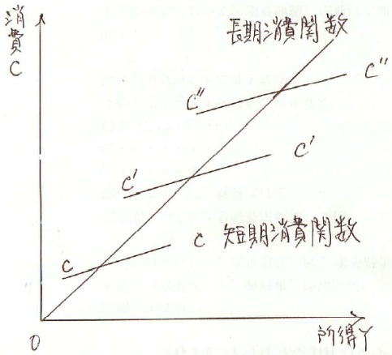
３．Short-run and Long-run Consumption Functions 短期と長期の消費関数
Simon Kuznets ⇒ Measured consumption functions of absolute income
hypothesis using time series data of the United States
Short-run consumption function ⇒ absolute income hypothesis is reasonable
long-run consumption function ⇒ Absolute income hypothesis is not valid as it goes through the origin point.
Long-run marginal propensity to consume c is 0.9, and larger than short-run marginal propensity.
Controversy over consumption functions
サイモン・クズネッツ⇒アメリカの時系列データを用いて、絶対所得仮説の消費関数を計測
短期の消費関数⇒絶対所得仮説が妥当
長期の消費関数⇒原点を通るので、絶対所得仮説
は妥当しない
長期の限界消費性向cは短期のそれより大きい、0.9
消費関数論争（controversy over consumption
functions）

Slide 8
４．Cross-section Short-run Consumption Function クロスセクションの短期消費関数
Cross section data
= Data that recorded about a variable for various places or subjects at one point of time, example: Height of 100 people as of 2010
Time series data
= Data that recorded the amount by which a variable changes over time, example: Measure and record the height of a person every year from 2000 to 2010
横断面データ（クロスセクション・データ、cross-section data）
＝ある変数を1時点でさまざまな場所とか主体について記録したデータ
例：2010年の時点での100人の身長
時系列データ（タイムシリーズ・データ、time series data）
＝ある変数が時間の経過に沿って変化する量を記録したデータ
例：ある人の身長を2000年から2010年まで毎年何センチか測定して記録

Slide 9
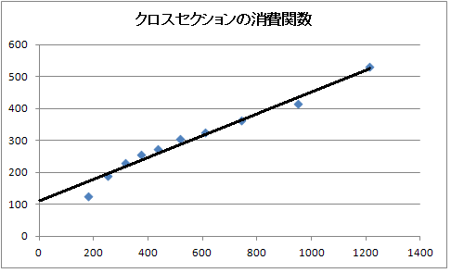
４B．Cross-section Short-run Consumption Function クロスセクションの短期消費関数
From the Annual Report of Family Income and Expenditure by the Ministry of Internal Affairs, take the annual income of the household's 10 ranks as income data and take the annual consumption expenditure (living expenses) of the household as consumption data⇒ Show that relationship in FY 2010
Scattered graph and observed value By Least Squared Method, we obtain
Regression equation
C = 108 + 0.35 Y, R² = 0.95
Estimated value = theoretical value
総務省の『家計調査年報』から、所得データとして世帯
の十分位階級の年間収入を取り、消費データとして世
帯の年間消費支出（生計費）を取る⇒2010年度のその
関係を表す
撒布図（scattered graph）と観測値（observed value）
最小自乗法（Least Squared Method）による
回帰式（regression equation）
C＝108＋0.35Y R²＝0.95
計測値（estimated value）＝理論値（theoretical
value）

Slide 10
４C．Cross-section Short-run Consumption Function クロスセクションの短期消費関数
The basic consumption of an average household is about 1.8 million yen per year,
the marginal propensity to consume is 0.35.
The average household size in 2010 is 2.47 people,
and the basic consumption per capita is about 437,000 yen per year.
As tax-free minimum income guaranteed by Article 25 of the Constitution
that "people have the right to live a minimum of cultural life",
income deductions such as basic deduction is now 380,000 yen per year
(about 32,000 yen per month ) R²＝0.95 coefficient of determination
基礎消費は1世帯平均で年間約108万円、限界消費性向は0.35。2010年の平均世帯人数は2.47人、1人当たりの基礎消費は年間約43万7千円。
「国民は文化的にして最低限度の生活を営む権利を有する」という憲法第25条が保障する非課税の最低所得として、基礎控除などの所得控除は現在は年38万円（月約3.2万円）
R²＝0.95 決定係数（coefficient of determination）

Slide 11
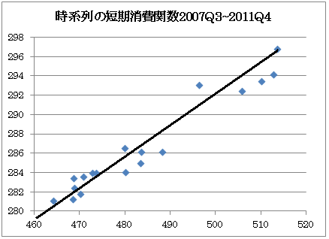
５．Time-Series Short-run Consumption Function タイムシリーズの短期消費関数
From "National Accounts Calculation (GDP statistics)" of the Cabinet Office, we take seasonally adjusted nominal Gross Domestic Product (GDP) as income data, seasonally adjusted private final consumption expenditure as consumption data ⇒to depict scattered graph. Quarterly data are converted to annualized data. Sample period = 3rd quarter 2007 Q3- 4th quarter 2011 Q4 Income (unit: trillion yen) on the horizontal axis, consumption (unit: trillion yen) on the vertical axis to obtain the regression equation; C＝146＋0.29Y R²＝0.94
内閣府の『国民経済計算（GDP統計）』、所得データ
として季節調整済みの名目国内総生産GDP（名目
国内総支出GDE）、消費データとして季節調整済み
の民間最終消費支出⇒撒布図（scattered graph）
四半期データを年額換算
標本期間（sample period）＝2007年第3四半期Q3
～2011年第4四半期Q4
横軸に所得（単位:兆円）、縦軸に消費（単位:兆円）
C＝146＋0.29Y R²＝0.94

Slide 12
５B．Time-Series Short-run Consumption Function タイムシリーズの短期消費関数
The basic consumption indicated by the constant term is about 146 trillion
yen per year in the whole country and the marginal propensity to consume is
0. 29. The total population of Japan in 2010 is 127.5 million people.
Basic consumption per capita is about 1.14 million yen per year.
This is considerably higher than the basic consumption measured from the
data of " Annual Report of Family Income and Expenditure “
The gross domestic product of "National Accounts (GDP Statistics)" includes not only households but also income of all economic agents such as enterprises, schools, hospitals, and governments.
定数項で示される基礎消費は国内全体で年間約146兆円、限界消費性向は0.29。2010年の日本の総人口は1億2750万人、1人当たりの基礎消費は年間約114万円。これは『家計調査年報』のデータから計測された基礎消費よりかなり高い数値
『国民経済計算・GDP統計』の国内総生産は家計世帯だけでなく企業や学校、病院、政府などすべての経済主体の所得を含んでいる

Slide 13
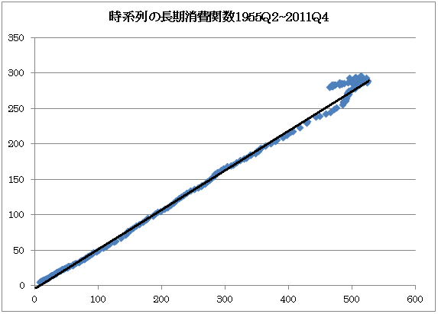
６．Time-Series Long-run Consumption Function タイムシリーズの長期消費関数
Sample period = 56 years from 1955 Q2 to 2011 Q4 Scatter diagram of relationship between income data and consumption data Income (unit: trillion yen) on the horizontal axis, consumption (unit: trillion yen) on the vertical axis Long-run consumption function C＝-3.8＋0.57Y R²＝0.99 The basic consumption a is about -3.8 trillion yen annually for the whole country, about -2500 yen per person per person when dividing by the population of 2010, almost zero.
The marginal propensity to consume is 0.57.
標本期間＝1955年第2四半期Q2～2011年第4
四半期Q4までの56年間
所得データと消費データとの関係を散布図
横軸に所得（単位:兆円）、縦軸に消費（単位:兆円）
長期消費関数は、 C＝-3.8＋0.57Y R²＝0.99
基礎消費aは国内全体で年間約－3.8兆円、2010年
の人口で割ると1人当たり月額約－2500円、ほぼ
ゼロに近い。限界消費性向は0.57。

Slide 14
６B．Time-Series Long-run Consumption Function タイムシリーズの長期消費関数
Basic consumption a increases with the income level Y rises．
⇒ a is a function of Y and variable. a＝a（Y）
Specify a＝a（Y）＝bY , C＝bY＋cY＝（b＋c）Y
Since the marginal propensity to consume becomes b + c, it is larger than c by b ⇒ It can explain consistently the difference between the natures of short-run and long-run consumption functions
基礎消費aは所得水準Yの上昇と共に増加する⇒a＝a（Y）とYの関数で可変
a＝a（Y）＝bYと特定化⇒ C＝bY＋cY＝（b＋c）Y
限界消費性向はb＋c となるのでcよりbの分だけ大
⇒短期と長期の消費関数の性質の違いを、矛盾なく整合的に説明

Slide 15
７．Consumption & Savings and Relative Income: Relative Income Hypothesis 消費・貯蓄と相対所得：相対所得仮説
Relative income hypothesis = idea that consumption depends not only on the absolute level of income but also on relative income Modigliani ⇒ Consumers want to maintain the standard of living at the highest income Y_{max} earned in the past, so consumption and savings depend not only on absolute income Y but also on historical highest incomes Y_{max} S＝（1－c ）Y＋α（Y－Y_{max}） C＝c Y－α（Y－Y_{max}） When consumption Y is larger than Y_{max}, consumption is suppressed,
and when Y is smaller than Y_{max}, savings are withdrawn and consumption is increased.
相対所得仮説（relative income hypothesis）＝消費が所得の絶対水準だけでなく相対所得にも依存して決まるという考え方
モジリアーニ⇒消費者は過去に得た最高所得Y_{max}の時の生活水準を維持したいと思うので、消費や貯蓄は絶対所得Yだけでなく過去の最高所得Y_{max}にも依存
S＝（1－c ）Y＋α（Y－Y_{max}） C＝c Y－α（Y－Y_{max}）
Y_{max}より所得Yが多いときには消費を抑え、Y_{max}よりYが小さいときには貯蓄を取り崩して消費を増やす。

Slide 16
７B．Consumption & Savings and Relative Income: Relative Income Hypothesis 消費・貯蓄と相対所得：相対所得仮説
Average propensity to save and average propensity to consume S ／Y＝（1－c ）＋α（Y－Y_{max}）／Y C ／Y＝c －α（Y－Y_{max}）／Y ⇒ When the income Y is larger than Y_{max} during the economic recovery period, the average propensity to consume decreases, and when Y is smaller than Y_{max} during the recession phase, the average propensity to consume increases. When the highest income Y_{max} is maintained in a steady state for a long run, and Y＝Y_{max}, S / Y = (1 - c), C / Y = c and both average propensities to save and consume unchanged.
Overtime relative income hypothesis, ratchet effect by Duesenberry
平均貯蓄性向や平均消費性向
S ／Y＝（1－c ）＋α（Y－Y_{max}）／Y C ／Y＝c －α（Y－Y_{max}）／Y
⇒景気回復期にY_{max}より所得Yが多いときには平均消費性向は下がり、景気後退期にY_{max}よりYが小さいときには平均消費性向が上がる。
最高所得Y_{max}が、長期的にずっと維持されている定常状態にある場合には、Y＝Y_{max}であるから、S ／Y＝（1－c ）、C ／Y＝c となって平均貯蓄性向も平均消費性向も一定で、それぞれ限界貯蓄性向と限界消費性向に一致。
時間的な相対所得仮説、デューゼンベリーの歯止め効果（ratchet effect）

Slide 17
７C．Consumption & Savings and Relative Income: Relative Income Hypothesis 消費・貯蓄と相対所得：相対所得仮説
Spatial relative income hypothesis, Duesenberry = The i th consumer is affected not only by its absolute income Y_{i}, but also by the relative income RY_{i} that shows which income class belongs to.⇒ Demonstration effect C_{i}＝cY_{i}＋βRY_{i} Average propensity to consume C_{i}／Y_{i}＝c＋βRY_{i}／Y_{i} ⇒ When incomes Y_{i} are more than relative income RY_{i}, we refrain from consumption. When Y_{i} is smaller than relative income RY_{i}, we try to increase consumption. In the long run, the income Y_{i} of yourself also increases as the relative income RY_{i} of the income class to which you belong, so it becomes RY_{i} = Y_{i}, C_{i}／Y_{i}＝c＋β
空間的な相対所得仮説、デューゼンベリー＝i番目の消費者はその絶対所得Y_{i}だけでなく、どの所得階級に属するかを示す相対所得（relative income）RY_{i}にも影響を受ける⇒デモンストレーション効果（demonstration effect）
C_{i}＝cY_{i}＋βRY_{i}
平均消費性向 C_{i}／Y_{i}＝c＋βRY_{i}／Y_{i}
⇒相対所得RY_{i}よりも所得Y_{i}が多いときは消費を控え、相対所得RY_{i}よりもY_{i}が少ないときは消費を増やそうとする
長期的には自分の所得Y_{i}も自分が属する所得階級の相対所得RY_{i}も同じように増えるので、RY_{i}＝Y_{i}となり、平均消費性向は、C_{i}／Y_{i}＝c＋β となる。

Slide 18
８．Consumption＆Savings and Liquid Assets: Liquid Asset Hypothesis 消費・貯蓄と流動資産：流動資産仮説
Tobin's liquid asset hypothesis ⇒ Liquid assets M such as cash, deposits, bonds, stocks, etc. are easy to convert to money, so they affect consumption. Consumption is a function of not only absolute income Y but also of liquid assets M. C ＝a＋cY＋γM
Average propensity to consume C ／Y＝a／Y＋c＋γM／Y
As income Y increases in the short run, both a / Y and M / Y go down, so the average propensity to consume also declines.
As income Y decreases, both a / Y and M / Y go up, so the average propensity to consume increases.
In the long run, as income Y increases, a / Y falls, but liquid assets M increase further, M / Y = Marshall's k rises, and offset each other and C / Y is constant.
Divided by the price level P, the real consumption function C／P＝a＋cY／P＋γM／P
トービンの流動資産仮説（liquid asset hypothesis）
⇒現金、預金、債券、株式などの流動資産Mは換金が容易なので消費に影響を与える。消費が絶対所得Yだけでなく、流動資産Mの関数。C ＝a＋cY＋γM
平均消費性向 C ／Y＝a／Y＋c＋γM／Y
短期的には所得Yが増えると、a／YもM／Yも下がるので、平均消費性向も下がり、所得Yが減ると、a／YもM／Yも上がるので、平均消費性向も上がる。
長期的には、所得Yが増えると、a／Yは下がるが、流動資産Mがそれ以上に増えてM／Y＝マーシャルのｋは上昇し、相殺し合ってC ／Yは一定。
物価水準Pで割ると、実質値の消費関数 C／P＝a＋cY／P＋γM／P

Slide 19
８B．Consumption＆Savings and Liquid Assets: Liquid Asset Hypothesis 消費・貯蓄と流動資産：流動資産仮説
When consumers can not sensitively nor accurately grasp the fluctuation of the price P and can not correctly incorporate it into consumer behavior, there is money illusion
Real cash balance effect, Pigovian effect = The real balance of liquid assets M / P changes due to a change in the price P, and it can affect consumption etc. This effect is called real cash balance effect.
At a time of recession, real income Y / P decreases and real consumption C / P decreases, but since M remains constant and P falls, then real balance of liquid assets M / P increases. Therefore the decrease in real consumption is partially offset.
At a time of recovery, real income Y / P increases and real consumption C / P increases , but since M remains constant and P rises, then real balance of liquid assets M / P decreases. Therefore the increase in real consumption is partially offset.
消費者が物価Pの変動を敏感にしかも正確に把握できず、消費行動に正確に織り込むことができない場合は、貨幣錯覚（money illusion）がある
実質現金残高効果（real cash balance effect）、ピグウ効果（Pigovian effect）
＝物価Pの変化によって実質流動資産残高M／Pが変化し、それが消費などに影響を与える効果
景気後退時には実質所得Y／Pは減り、実質消費C ／Pも減るが、Mはほぼ一定のままPが下落するので実質流動資産残高M／Pは増える。すると実質消費の減少は一部相殺される。
景気回復時には実質所得Y／Pは増え、実質消費C ／Pも増えるが、Mはほぼ一定のままPが上昇するので実質流動資産残高M／Pは減る。すると実質消費の増加は一部相殺される。

Slide 20
９．Consumption & Savings and Permanent Income: Permanent Income Hypothesis 消費・貯蓄と恒常所得:恒常所得仮説
Milton Friedman's permanent income hypothesis
Permanent consumption CP = a planned part of consumption at every period such as electricity fee, food expenses, educational expenses etc.
Transitory consumption CT = the other remaining part of consumption such as unexpected expense etc.
Permanent income YP = income which is constantly gained at every period as salary
Transitory income YT = the other temporary income such as lottery prize etc.
The two-period model, total asset W is the sum of the initial asset A₀ at the beginning and the income Y₀ at the current period and the discounted present value Y₁／(1＋i ) of the income Y₁ at the next period. i is the market interest rate. W ＝A₀＋Y₀＋Y₁／(1＋i )＝A₀＋Σ_{t=0}¹ Y_{t}／(1＋i )^{t} The permanent income is the average income. W＝Y_{P}＋Y_{P}／(1＋i)＝Σ_{t=0}¹ Y_{P}／(1＋i)^{t} Calculate Y_{P} to make both equations equal.
ミルトン・フリードマンの恒常所得仮説（permanent income hypothesis）
恒常消費（permanent consumption）C_{P}＝電気代や食費、教育費など毎期計画的に消費する部分
変動消費（transitory consumption）C_{T}＝予期せぬ出費などそれ以外の消費
恒常所得（permanent income）Y_{P}＝給与のように毎期決まって得られる所得
変動所得（transitory income）Y_{T}＝宝籤の賞金などそれ以外に一時的な所得
2期間モデル、総資産Wは期首の資産A₀と今期の所得Y₀、および来期の所得Y₁の割引現在価値Y₁／(1＋i )の合計。iは市場利子率。
W ＝A₀＋Y₀＋Y₁／(1＋i )＝A₀＋Σ_{t=0}¹ Y_{t}／(1＋i )^{t}
恒常所得は平均的な所得。
W＝Y_{P}＋Y_{P}／(1＋i)＝Σ_{t=0}¹ Y_{P}／(1＋i)^{t}
両式を等しくするY_{P} を計算。

Slide 21
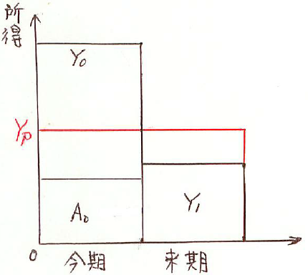
９B．Consumption & Savings and Permanent Income: Permanent Income Hypothesis 消費・貯蓄と恒常所得:恒常所得仮説
Transitory consumption and transitory income compensate plus or minus to zero in the long run.
When consumers plan their consumption plan, they do not consider unexpected transitory consumption C_{T}in advance, so they plan a consumption plan of permanent consumption CP, based on permanent income Y_{P}. C＝C_{P}＝c Y_{P}
Average propensity to consume= C /Y＝C_{P}/(Y_{P}＋Y_{T})＝cY_{P}/(Y_{P}＋Y_{T})＝c/(1＋Y_{T}/Y_{P})
In the boom period, transitory income Y_{T} increases, the ratio(Y_{T}／Y_{P}) rises and C／Y falls.
In the recession period, transitory income Y_{T} decreases, the ratio of （Y_{T}／Y_{P}） falls, and C／Y rises.
In the long term, both transitory income and transitory consumption are deducted zero, long-run average propensity to consume is C ／Y＝C_{P}／Y_{P}＝c
変動消費や変動所得は長期的にはプラス・マイナスでゼロ。
消費者が消費計画を立てるときには、予期せぬ変動消費C_{T}は
予め考慮しないので、恒常消費C_{P}の消費計画を立て、恒常所得
Y_{P}に基づく。C＝C_{P}＝c Y_{P}
平均消費性向= C ／Y＝C_{P}／（Y_{P}＋Y_{T}）＝cY_{P}／（Y_{P}＋Y_{T}）
＝c／（1＋Y_{T}／Y_{P}）
好況期には、変動所得Y_{T}は増え、（Y_{T}／Y_{P}）の比率は上がり、
C／Yは下がる。
不況期には、変動所得Y_{T}は減り、（Y_{T}／Y_{P}）の比率は下がり、
C ／Yは上がる。
長期的には変動所得も変動消費も差し引きゼロ、長期の平均
消費性向は、C ／Y＝C_{P}／Y_{P}＝c

Slide 22
10．Life Cycle Hypothesis ライフサイクル仮説
Transitory consumption and transitory income compensate plus or minus to zero in the long run.
Life cycle hypothesis of Modigliani and Brunberg
Budget constraint is the discounted present value of lifetime income, to maximize a lifetime utility function ⇒ to determine the optimum consumption in each period according to life cycle
2 period model, total discounted present value of consumer's consumption,
The sum of the consumption C₀ in this period (young age) and the discounted present value of the consumption C₁ in the next period (old age)
＝C₀＋C₁／(1＋i)＝Σ_{t=0}¹ C _{t}／(1＋i)^{t}
The total asset W is the sum of the asset A₀ at the beginning and the income Y₁ at this period, and the discounted present value of the next income Y₁ at the future period Y₁／(1＋i)
＝W＝A₀＋Y₀＋Y₁／(1＋i)＝A₀＋Σ_{t=0}¹ Y_{t}／(1＋i)^{t}
変動消費や変動所得は長期的にはプラス・マイナスでゼロ。
モジリアーニとブルンバーグのライフサイクル仮説（life cycle hypothesis）
生涯所得の割引現在価値を予算制約、生涯にわたる効用関数を最大化⇒ライフサイクルに応じた各期の最適消費を決定
2期間モデル、消費者の消費の割引現在価値の総額、
今期（若年期）の消費C₀と来期（老年期）の消費C₁の割引現在価値C₁／(1＋i)との合計＝C₀＋C₁／(1＋i)＝Σ_{t=0}¹ C _{t}／(1＋i)^{t}
総資産Wは，期首の資産A₀と今期の所得Y₀、来期の所得Y₁の割引現在価値Y₁／(1＋i)の合計＝W＝A₀＋Y₀＋Y₁／(1＋i)＝A₀＋Σ_{t=0}¹ Y_{t}／(1＋i)^{t}

Slide 23
10B．Life Cycle Hypothesis ライフサイクル仮説
Consumers make lifetime consumption within the scope of this total asset, C₀＋C₁／(1＋i)＝A₀＋Y₀＋Y ₁／(1＋i ) ないし
Σ_{t=0}¹ C _{t}／(1＋i)^{t}＝A ₀＋Σ_{t=0}¹ Y _{t}／(1＋i )^{t}
C₀＋C₁／(1＋i)＝Y ₀＋Y ₁／(1＋i ) when there is no opening asset A ₀,
Maximize utility function u, determine optimal consumption C₀* and C₁* for each period u＝u（C₀，C₁）
The next Figure ⇒ Budget constraint equation and utility function (indifference curve)
The horizontal axis shows income and consumption of this period (young age), the vertical axis shows income and consumption of the next period (old age)
The maximum income A in this period is the sum of the beginning asset and income,
A ₀＋Y ₀
If you save all, you can also earn interest income, so the maximum income B in the next period, (A ₀＋Y ₀)(1＋i )＋Y ₁
消費者はこの総資産の範囲で生涯の消費を行う、
C₀＋C₁／(1＋i)＝A₀＋Y₀＋Y ₁／(1＋i ) ないし
Σ_{t=0}¹ C _{t}／(1＋i)^{t}＝A ₀＋Σ_{t=0}¹ Y _{t}／(1＋i )^{t}
期首資産A ₀がない場合は、 C₀＋C₁／(1＋i)＝Y ₀＋Y ₁／(1＋i )
効用関数uを最大化し、各期の最適消費C₀*およびC₁*を決定 u＝u（C₀，C₁）
次の図⇒予算制約式と効用関数（無差別曲線）
横軸には今期（若年期）の所得と消費、縦軸には来期（老年期）の所得と消費
今期の最大収入A点は期首資産と所得の合計で、A ₀＋Y ₀
すべて貯蓄すれば、利子収入も得られるので、来期の最大収入B点では、
(A ₀＋Y ₀)(1＋i )＋Y ₁

Slide 24
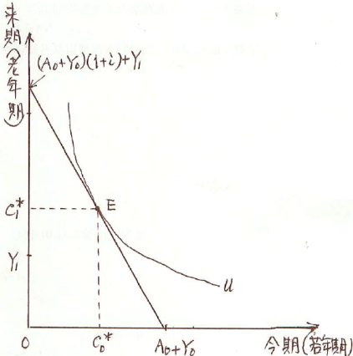
10C．Life Cycle Hypothesis ライフサイクル仮説
Maximizing utility within the scope of the budget constraint is the point of contact E ⇒Optimum consumption C₀* and C₁* are determined
As an interest rate rises, savings increase, the slope of the budget constraint line becomes steep, the optimal consumption point is E ‘
⇒ Present optimal consumption C₀* will decrease,
and future optimum consumption C₁* will increase.
In the short run, total lifetime wealth W does not
decrease so much even if income Y decreases,
consumption C does not decrease so much,
Average propensity to consume C / Y rather increases.
In the long run, if income Y increases, lifetime wealth W
also increases in the same way, so average propensity
to consume C / Y is constant.
予算制約の範囲内で効用を最大化するのは両者の接点E
⇒最適消費量C₀*およびC₁*が決定
利子率が上がると貯蓄が増え、予算制約線の傾きは急になり、最適消費点はE’
⇒今期の最適消費C₀*は減り、来期の最適消費C₁*が増える
短期では所得Y が減っても生涯の総資産Wはそれほど減らないので、消費Cもそれほど減らず、平均消費性向C／Y はむしろ上がる
長期においては所得Y が増えれば生涯の総資産Wも同じように増えるので、平均消費性向C／Y は一定

